Slide 1
Predictive Modeling BANA6660 Final Project
Takeshi “Mike” Tsuyuguchi

Slide 2
Final Project
Conduct similar analysis as project 1 for another dataset
Differences: Response variable is categorical (binary) use python to do the analysis and prediction
Goals Be more familiar with EDA in depth *Learn more graphical approaches in eda Be able to say ” I can use r or python !”

Slide 3

Dataset –Titanic Survivor
Data is obtained from the kaggle website
Response variable – Survived or not survived (binary)
Explanatory variables – 10 variables

Slide 4
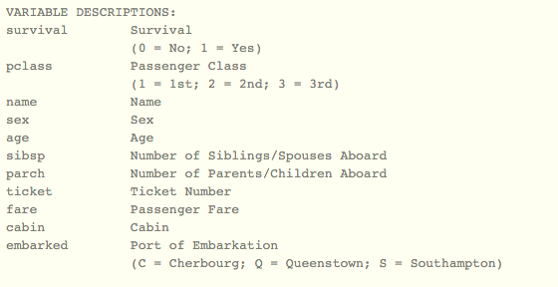
Explanatory Variables

Slide 5
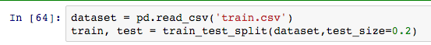
Keep the Test dataset
From the training dataset, I take
20% for the test dataset (models won’t see this, but I can calculate the score or accurasy)
80% for the training dataset

Slide 6
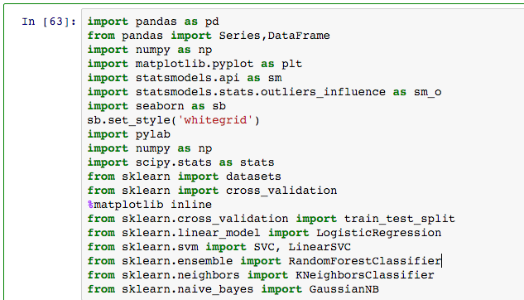
Packages…

Slide 7
EDA
Decide whether or not to keep the variables
Treat Missing or NA values (Categorical or numerical)
Median, most frequent values, or some random variables within the 1 SD.
Understanding the trend, we could use the test dataset, too
Have a validation dataset or do cross-validation to check the best model.

Slide 8
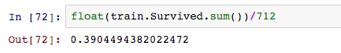
EDA –basic info
Survival rate is 39.04%
If any explanatory variable can predict much higher than this number, it would be useful.

Slide 9
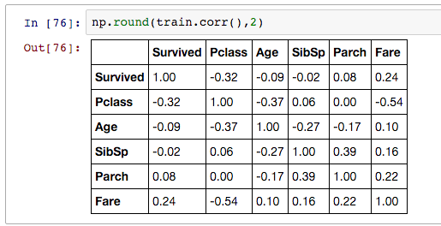
Correlation Matrix

Slide 10
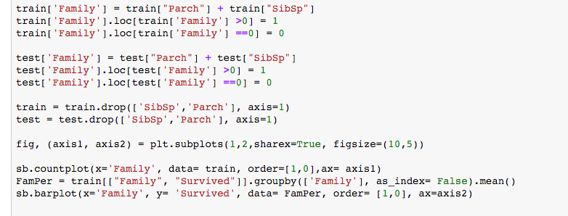
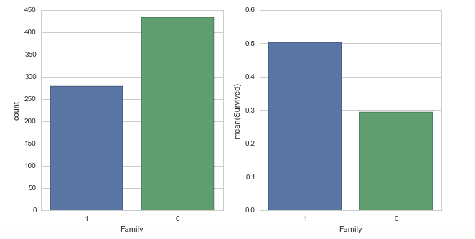
EDA –sibsp & Parch
Siblings & Spouses , Parents & Children tell us the same thing: whether or not that person was with their family or alone.
Therefore, I combined these two numerical variables together and make a new binary variable (0=individual, 1=with Family)

Slide 11
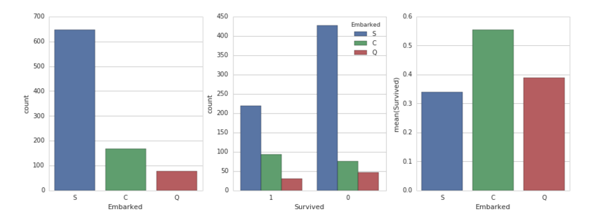
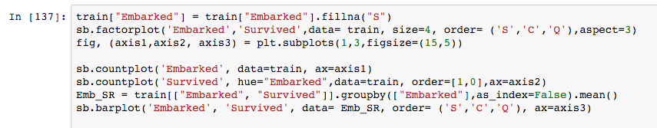
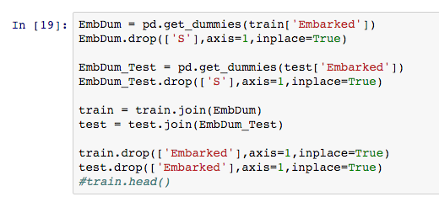
EDA -Embarked

Slide 12
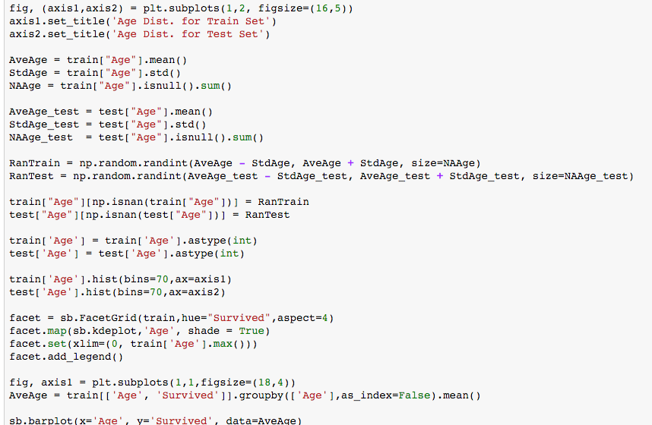
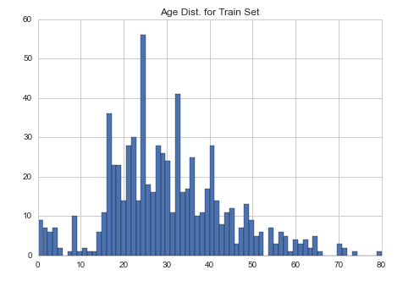
EDA -Age

Slide 13
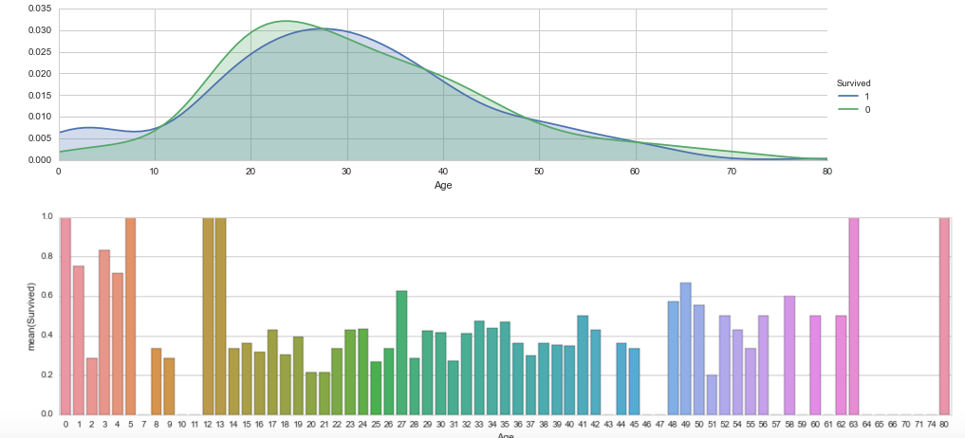
Survival rate by age

Slide 14
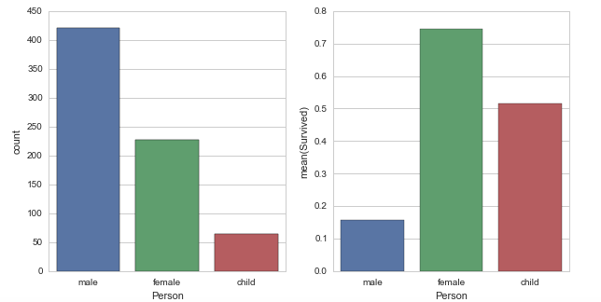
Gender & Children
Combining two different variables: age and Gender to create a new variable
Whether the person is male, female, or child.

Slide 15
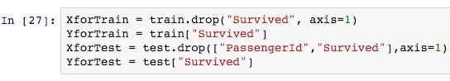
prediction
Make the dataset for x variables and y variable
That’s needed for the training and test dataset
Dataset for training and testing need to be identical

Slide 16
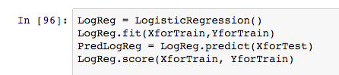
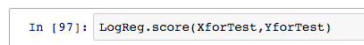
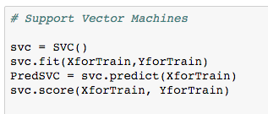
Models
Logistic regression
K-nearest neighbors
Support vector machines
Gaussian Naïve bayes
Random forest

Slide 17
Result
Model | Train Accu | Test Accu
Logistic Regression | 0.800 | 0.782
KNN | 0.847 | 0.737
Gaussian | 0.781 | 0.771
SVC | 0.889 | 0.726
RF | 0.985 | 0.801

